Slide 1

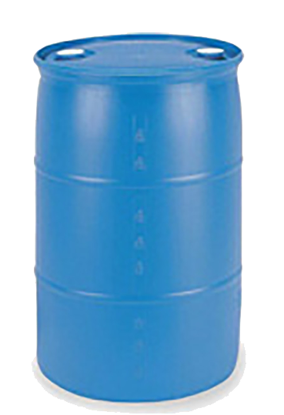
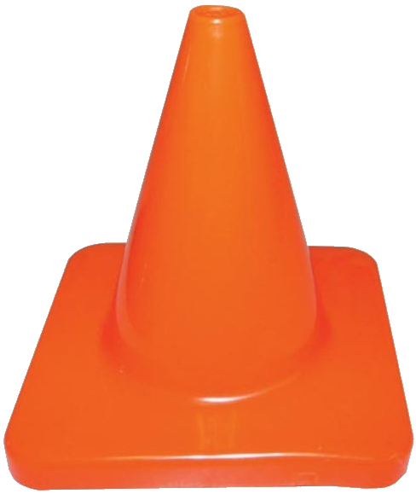


 | One Round Clipazines Course Designer: Kris Erickson |  |  |  |  | Bay 7
“The idea that we don't have elimination of assault-type weapons, magazines that can hold multiple bullets in them is absolutely mindless. It is no violation of the second amendment. It is just a bow to the special interests, the gun manufacturers, and the NRA. It's gotta stop.” – Joe Biden, September 2, 2019. SCENARIO: Let’s try it once Sleepy Joe’s way, then finish up using magazines that hold multiple bullets. It’s just common sense.
START POSITION: Standing at start position, gun loaded with ONE ROUND and holstered, hands naturally at sides, toes on line. PCC START: Standing at start position, rifle loaded with ONE ROUND, pointed at cone, toes on line. |  | STRINGS | CONCEALMENT |  | SCORING |  | TOTAL ROUNDS
 |  | 1 | REQUIRED |  | UNLIMITED |  | 13
 |  | TARGETS |  | 6 threat, 1 steel.
 |  | SCORED HITS |  | Best 2 per target, steel down.
STAGE PROCEDURE: Engage steel activator until it falls, then engage swinging target with 2 rounds from start position. Move to remaining positions, and engage remaining targets with 2 rounds each. |  | NOTES: Swinger may be reengaged on the way to P1, but not from around cover of P1 or from P2 (SO safety). Barrel obscures swinger in its starting position.
T1 & T2
Swinger
T3–T5
P2
P1
PCC
Cone
START
https://www.youtube.com/watch?v=sKYYWc_7_iU&t=81

